Slide 1
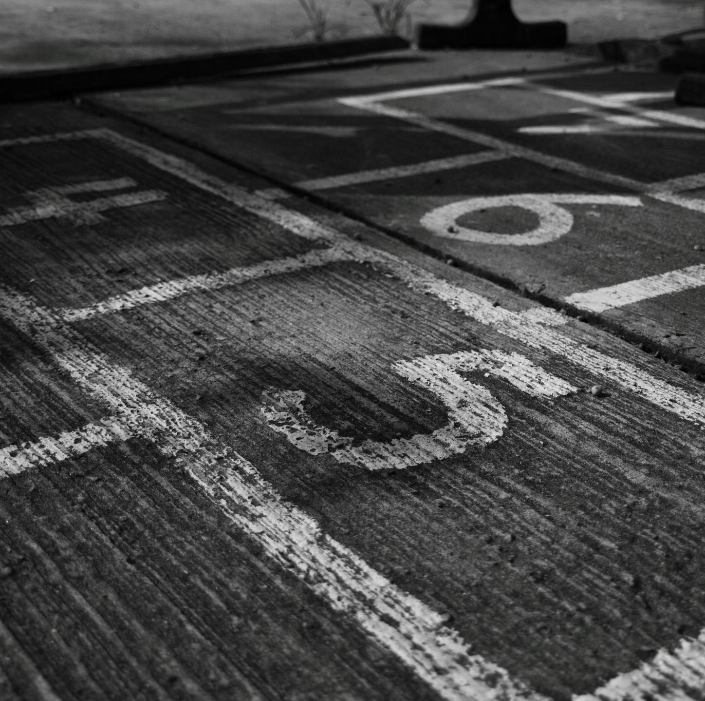
Week 3: Reference tracking and accessibility in Rezonator
Ryan Ka Yau Lai
University of California, Santa Barbara

Slide 2


Before we start …
Open sbc007.rez
If you have a file saved from last week’s section + show, please open that
If not, just open sbc007

Slide 3
Today’s question
Can you think of one way in which the concept of accessibility can be used to investigate social attitudes or prejudices using natural discourse data?

Slide 4
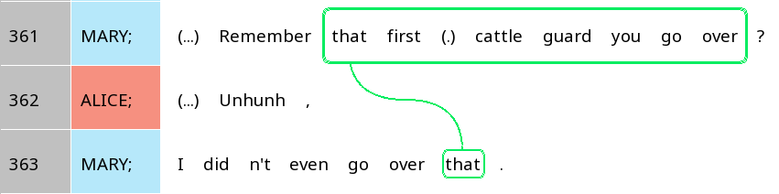
Examining coreference chains
Why are two different referential expressions used for the same entity?

Slide 5
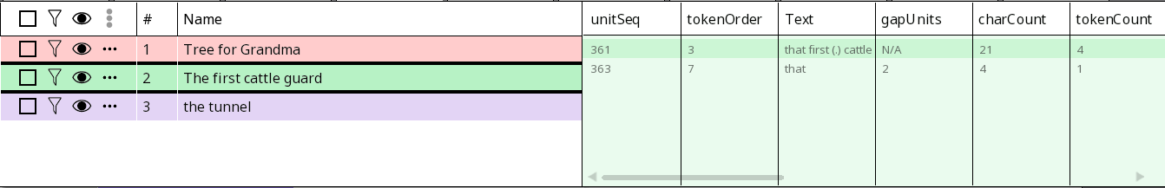
Understanding the nav window
unitSeq: Unit sequence
gapUnits: Number of units since the previous mention
Number of units since the previous mention
Unit sequence
How are these related to accessibility?

Slide 6
Understanding the nav window
charCount: Number of characters
tokenCount: Number of tokens
# of characters
# of tokens
How are these related to accessibility?

Slide 7
Shorter distance from previous mention (track)
Shorter referential expression
Higher accessibility
Larger number of previous mentions (farther along in trail)
Less specific referential expression
…
Any more you can think of?

Slide 8
Factors related to accessibility (in English)
Context | Properties of current mention | Inherent properties of referent
Shorter distance from previous mention (track) | Current grammatical role is subject | Animate, esp. human
Larger number of previous mentions (farther along in trail) | … | Women (Misogyny > Less perceived need to be clear about women’s identity)
Fewer competitors |  | Singular
Previous grammatical role is subject |  | …
…
How might these be represented in Rezonator?

Slide 9
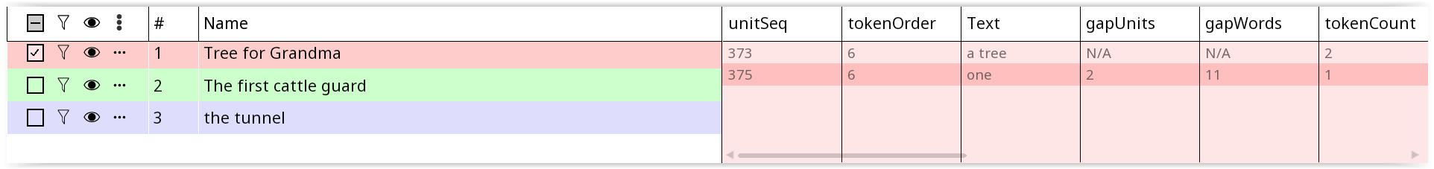
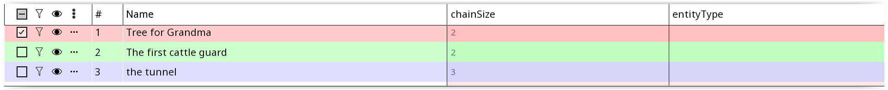
One-to-one vs. one-to-many
One-to-many: One trail – Many tracks
One-to-one: One trail – One trail

Slide 10
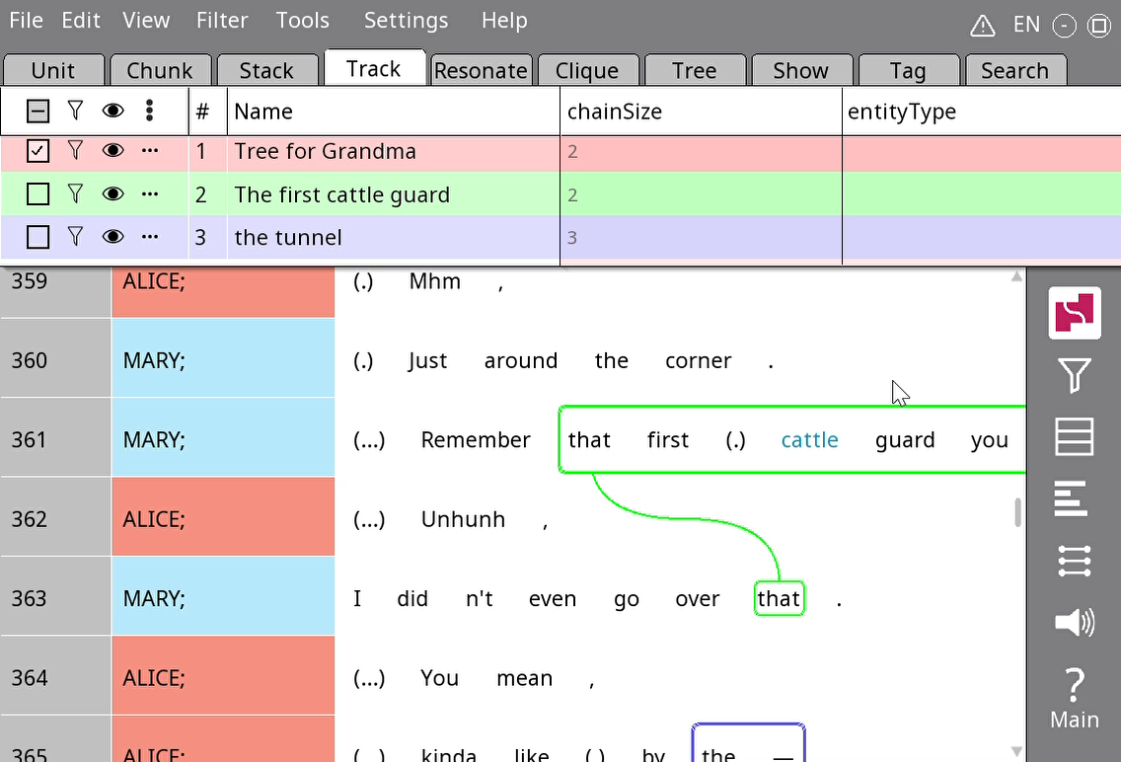
Changing the entity type of trails
Field
Tags

Slide 11
Your turn!
Find two referents that are mentioned at least four times: One animate (i.e. human/animal), one inanimate
Create two trails and observe how the length of individual mentions (tracks) change over the course of the trail
Once you’re done, share with your partner what differences you found!

Slide 12
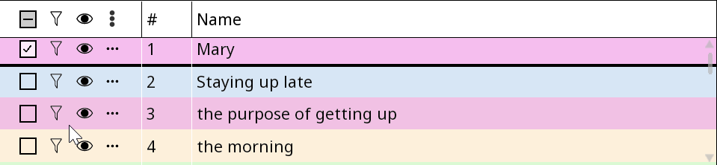
Show/hide and filtering in Rezonator
Filtering: Show only some rows relevant to the trail
Show/hide: Show/hide annotations, i.e. trail boxes/lines

Slide 13
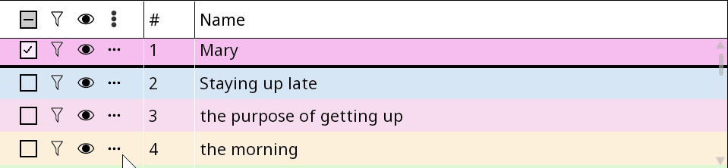
Show/hide
Show/hide ALL trails
Show/hide individual trails

Slide 14

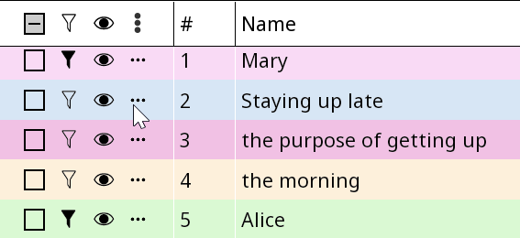
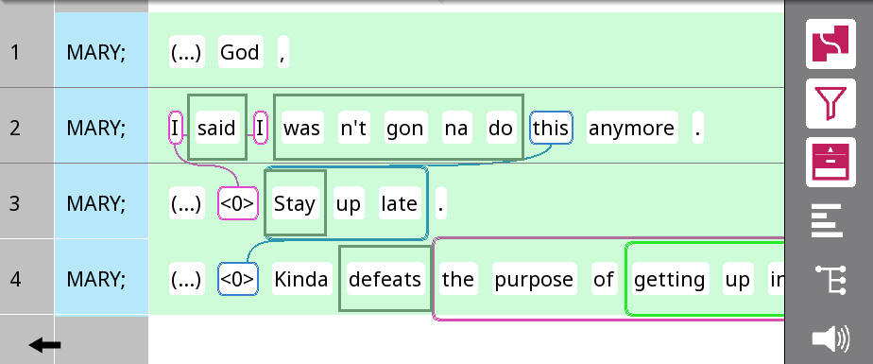
Filtering
Select filtering modes
Context below trail
Select trails to see
Context between tracks
Context above trail
3. Filter!

Slide 15
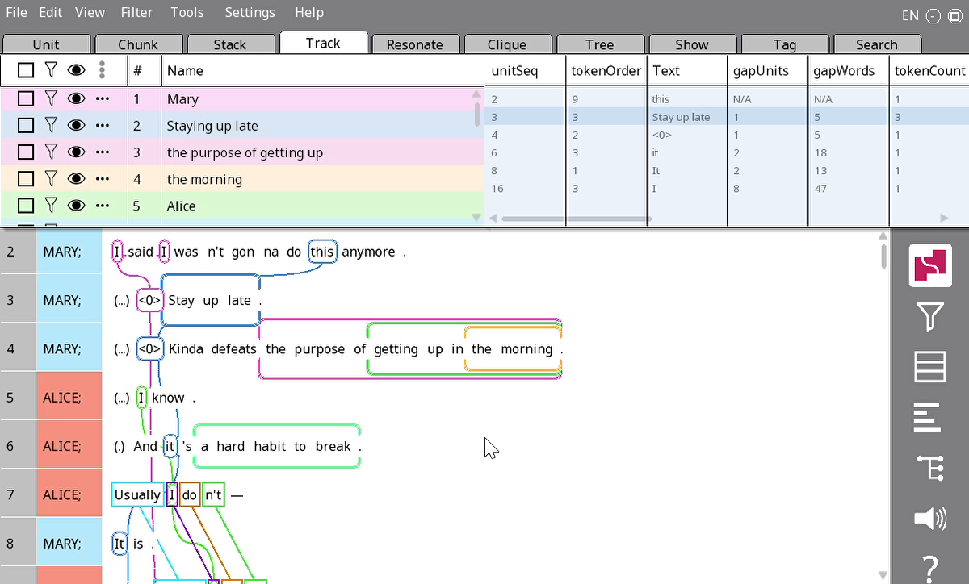
Some keyboard shortcuts
Quick pick: Type ‘p’ to filter on a specific track while it is in focus
Context: Type ‘c’ to quickly toggle between showing space between tracks, and not showing them

Slide 16

Your turn!
Pick one trail you already have, and track its appearance across the first ~50 lines from the first mention nof the referent. You can expand from some of your previous annotations.
Use the Quick Pick function to filter on that trail, and tell your partner what’s going on in the trail, e.g.:
What forms did the speaker choose in each track?
Why does the speaker choose this form?

Slide 17
Accessibility once more
Shorter distance from previous mention (track)
Shorter referential expression
Higher accessibility
Larger number of previous mentions (farther along in trail)
Less specific referential expression
…
How short can we get?

Slide 18
Accessibility hierarchy
Full noun phrases
Noun phrase with relative clause: The person who stole the watch
Proper name: Mary
Pronouns
Demonstrative pronoun: That, these
?
Can we go smaller?
Noun phrase with adjective: The funny person
Personal pronoun: She, it
Increasing accessibility

Slide 19
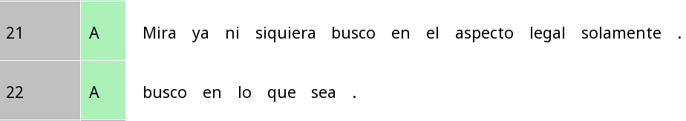
Verb morphology as person marking
Look (I) am not even looking just in the legal aspect.
(I) am looking everywhere.
How many referential expressions?

Slide 20
Verb morphology as person marking
Look (I) am not even looking just in the legal aspect.
(I) am looking everywhere.
Person | Verb form
1 | Busc-o
2 | Busc-as
3 | Busc-a

Slide 21
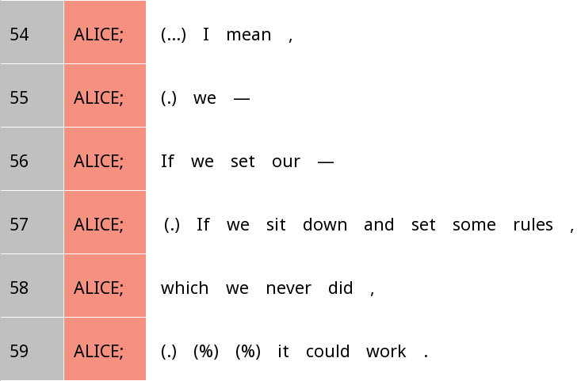
How about English?
Who is setting rules here?

Slide 22
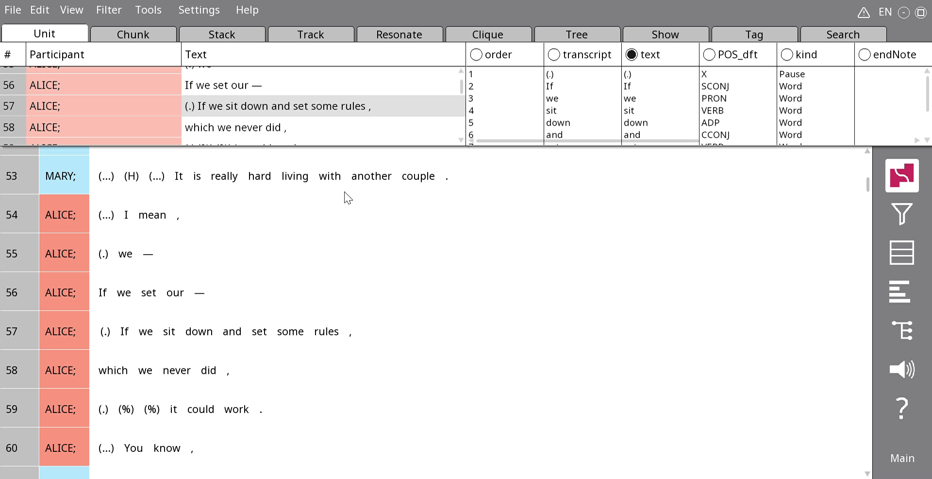
Inserting zeros in Rezonator
Note: We typically insert a zero where a pronoun might have appeared

Slide 23
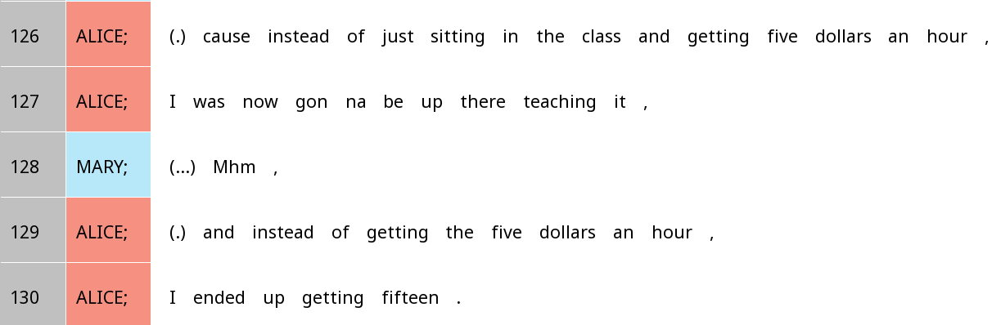
Spot the zeros

Slide 24
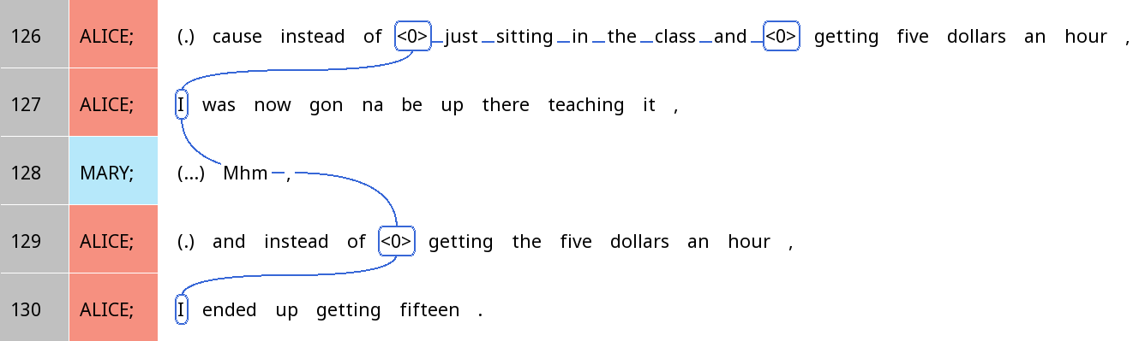
Cataphora

Slide 25

Spotting zeroes
When you see a verb, ask yourself: Is there someone or something you can infer as being involved in this event/state that is not explicitly mentioned?

Slide 26
Your turn!
Find one example of a zero in SBC007 that we haven’t discussed
Create a coreference chain, including all mentions of the same referent within ten IUs (i.e. if the zero is on line 20, do lines 10-30)
Tell your partner a) why you think the speaker did not mention the referent specifically, and b) how you think the listener might figure out the referent
Bonus: Why did the speaker not use a zero in other cases?

Slide 27
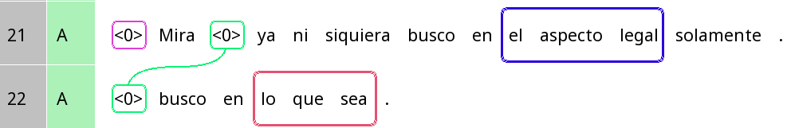


Studying pronoun absence in Spanish
These are not ‘true’ zeroes since the actual referential expressions are on the verb!
But we mark them as zeroes anyways (since the suffix is not a separate token in these texts
Look (I) am not even looking just in the legal aspect.
(I) am looking in whatever.

Slide 28
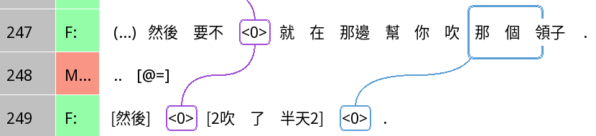
Studying zeroes in Chinese
The ‘he’ is a barber (mentioned in previous context)
Important: Zeroes not limited to ‘subjects’ but also ‘objects’
Then, otherwise, (he) was there helping you blow that collar
Then (he) blew (it) for half a day (i.e. a long time).

